Slide 1

Multidimensional Arrays
TUIT
C++ Programming, Fall 2016
Lecture #8

Slide 2
TUIT
Roadmap
Last week we covered
Single-Dimensional Arrays and C-Strings
This week we will learn
Introduction
Declaring Two-Dimensional Arrays
Processing Two-Dimensional Arrays
Passing Two-Dimensional Arrays to Functions
Problem: Grading a Multiple-Choice Test
Problem: Finding a Closest Pair
Problem: Sudoku
Multidimensional Arrays

Slide 3
TUIT
Introduction
Data in a table or a matrix can be represented using a two – dimensional array.
 | Chicago | Boston | New York | Atlanta | Miami | Dallas | Houston
Chicago | 0 | 983 | 787 | 714 | 1375 | 967 | 1087
Boston | 983 | 0 | 214 | 1102 | 1763 | 1723 | 1842
New York | 787 | 214 | 0 | 888 | 1549 | 1548 | 1627
Atlanta | 714 | 1102 | 888 | 0 | 661 | 781 | 810
Miami | 1375 | 1763 | 1549 | 661 | 0 | 1426 | 1187
Dallas | 967 | 1723 | 1548 | 781 | 1426 | 0 | 239
Houston | 1087 | 1842 | 1627 | 810 | 1187 | 239 | 0

Slide 4
TUIT
Declaring Two-Dimensional Arrays
An element in a two-dimensional array is accessed through a row and column index. The syntax for declaring a two-dimensional array is
elementType arrayName[ROW_SIZE][COLUMN_SIZE];
As an example, here is how o declare a two-dimensional array matrix of int values:
int matrix[5][5];

Slide 5
TUIT
Declaring Two-Dimensional Arrays
 | [0] | [1] | [2] | [3] | [4]
[0]
[1]
[2]
[3]
[4]
 | [0] | [1] | [2] | [3] | [4]
[0]
[1]
[2] |  | 7
[3]
[4]
 | [0] | [1] | [2]
[0] | 1 | 2 | 3
[1] | 4 | 5 | 6
[2] | 7 | 8 | 9
[3] | 10 | 11 | 12
int matrix[4][3] =
{{1, 2, 3},
{4, 5, 6},
{7, 8, 9},
{10, 11, 12}
};
int matrix[5][5];
matrix[2][1] = 7;

Slide 6
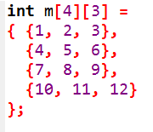
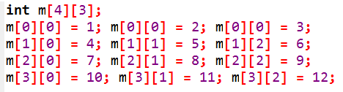
TUIT
Caution
It is a common mistake to use matrix[2, 1] to access the element at row 2 and column 1. In C++, each subscript must be enclosed in a pair of square brackets.

Slide 7
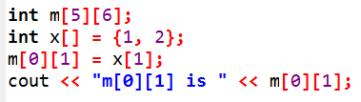
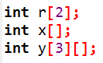
TUIT
Check Point
What is the output of the following code?
Which of the following statements are valid array declarations?

Slide 8
TUIT
Processing Two-Dimensional Arrays
Nested for loops are often used to process a two-dimensional array.
Suppose an array matrix is declared as follows:
const int ROW_SIZE = 10;
const int COLUMN_SIZE = 10;
int matrix[ROW_SIZE][COLUNM_SIZE];

Slide 9
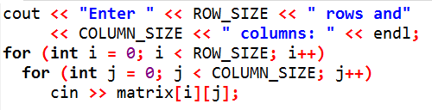
TUIT
Processing Two-Dimensional Arrays
1. Initializing arrays with input values. The following loop initializes the array with user input values:

Slide 10
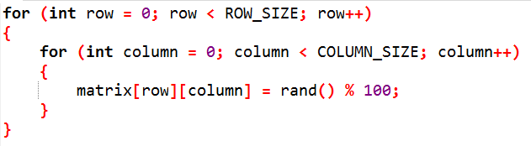
TUIT
Processing Two-Dimensional Arrays
2. Initializing arrays with random values. The following loop initializes the array with random values between 0 and 99:

Slide 11
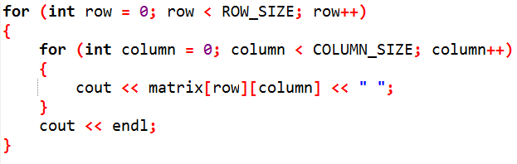
TUIT
Processing Two-Dimensional Arrays
3. Displaying arrays. To display a two-dimensional array, you have to display each element in the array using a loop like the following:

Slide 12
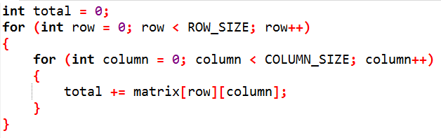
TUIT
Processing Two-Dimensional Arrays
4. Summing all elements. Use a variable named total to store the sum. Initially total is 0. Add each element in the array to total using a loop like this:

Slide 13
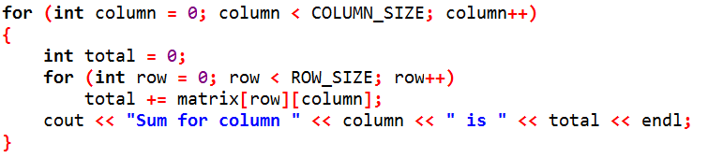
TUIT
Processing Two-Dimensional Arrays
5. Summing elements by column. For each column, use a variable named total to store its sum. Add each element in the column to total using a loop like this:

Slide 14
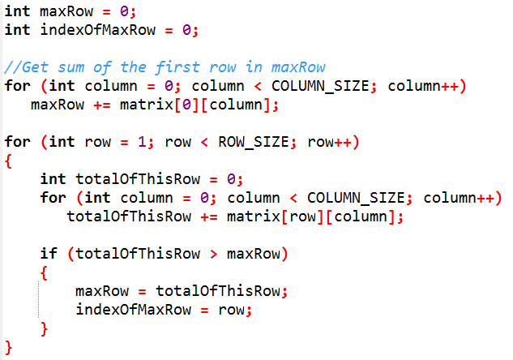
TUIT
Processing Two-Dimensional Arrays
6. Which row has the largest sum? Use variables maxRow and indexOfMaxRow to track the largest sum and index of the row. For each row, compute its sum and update maxRow and indexOfMaxRow if the new sum is greater.

Slide 15
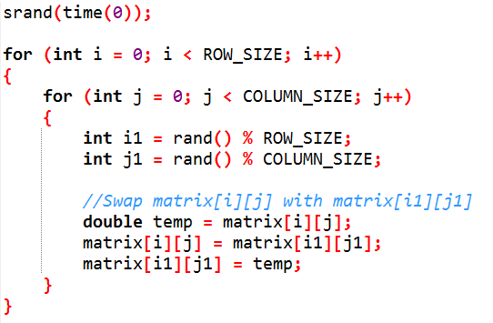
TUIT
Processing Two-Dimensional Arrays
7. Random shuffling. Shuffling the elements in a one-dimensional array was introduced in Lecture #7, “Processing Arrays.” How do you shuffle all the elements in a two-dimensional array? To accomplish this, for each element matrix[i][j], randomly generate indices i1 and j1 and swap matrix[i][j] with matrix[i1][j1], as follows:

Slide 16
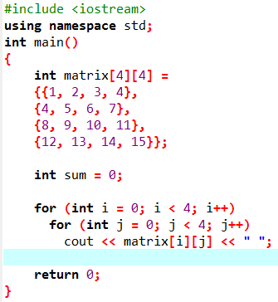
TUIT
Check Point
What is the output of the following code?

Slide 17

TUIT
Check Point
What is the output of the following code?

Slide 18
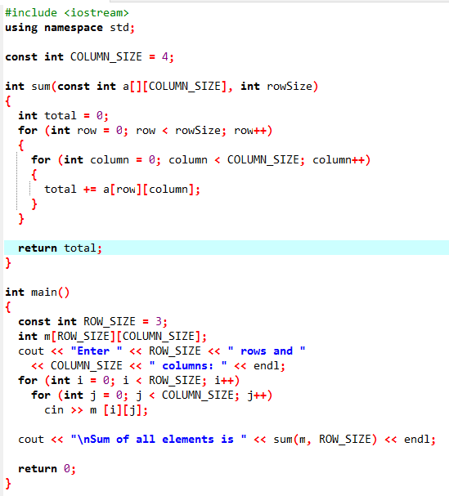


TUIT
Passing Two-Dimensional Arrays to Functions
When passing a two-dimensional array to a function, C++ requires that the column size be specified in the function parameter type declaration.
Enter 3 rows and 4 columns: 1 2 3 4 5 6 7 8 9 10 11 12 Sum of all elements is 78

Slide 19
TUIT
Problem: Grading a Multiple-Choice Test
The problem is to write a program that will grade multiple-choice tests. Suppose there are 8 students and 10 questions, and the answers are stored in a two-dimensional array. Each row records a student’s answers to the questions. For example, the following array stores the test.
 | 0 | 1 | 2 | 3 | 4 | 5 | 6 | 7 | 8 | 9
Student 0 | A | B | A | C | C | D | E | E | A | D
Student 1 | D | B | A | B | C | A | E | E | A | D
Student 2 | E | D | D | A | C | B | E | E | A | D
Student 3 | C | B | A | E | D | C | E | E | A | D
Student 4 | A | B | D | C | C | D | E | E | A | D
Student 5 | B | B | E | C | C | D | E | E | A | D
Student 6 | B | B | A | C | C | D | E | E | A | D
Student 7 | E | B | E | C | C | D | E | E | A | D

Slide 20
TUIT
Problem: Grading a Multiple-Choice Test
The key is stored in a one-dimensional array, as follows:
 | 0 | 1 | 2 | 3 | 4 | 5 | 6 | 7 | 8 | 9
key | D | B | D | C | C | D | A | E | A | D

Slide 21
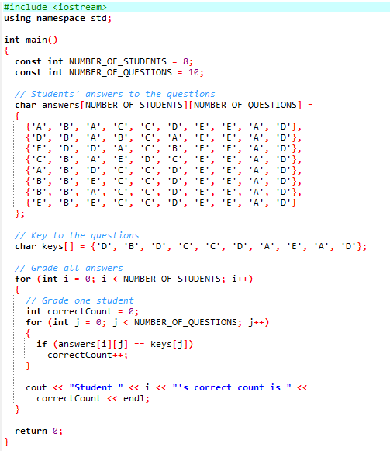
TUIT
Problem: Grading a Multiple-Choice Test
Student 0's correct count is 7 Student 1's correct count is 6 Student 2's correct count is 5 Student 3's correct count is 4 Student 4's correct count is 8 Student 5's correct count is 7 Student 6's correct count is 7 Student 7's correct count is 7

Slide 22
TUIT
Problem: Finding a Closest Pair
This section presents a geometric problem for finding the closest pair of points.
(-1, 3)
(3, 3)
 | x | Y
0 | -1 | 3
1 | -1 | -1
2 | 1 | 1
3 | 2 | 0.5
4 | 2 | -1
5 | 3 | 3
6 | 4 | 2
7 | 4 | -0.5
(4, 2)
(1, 1)
(2, 0.5)
(4, -0.5)
(-1, -1)
(2, -1)

Slide 23
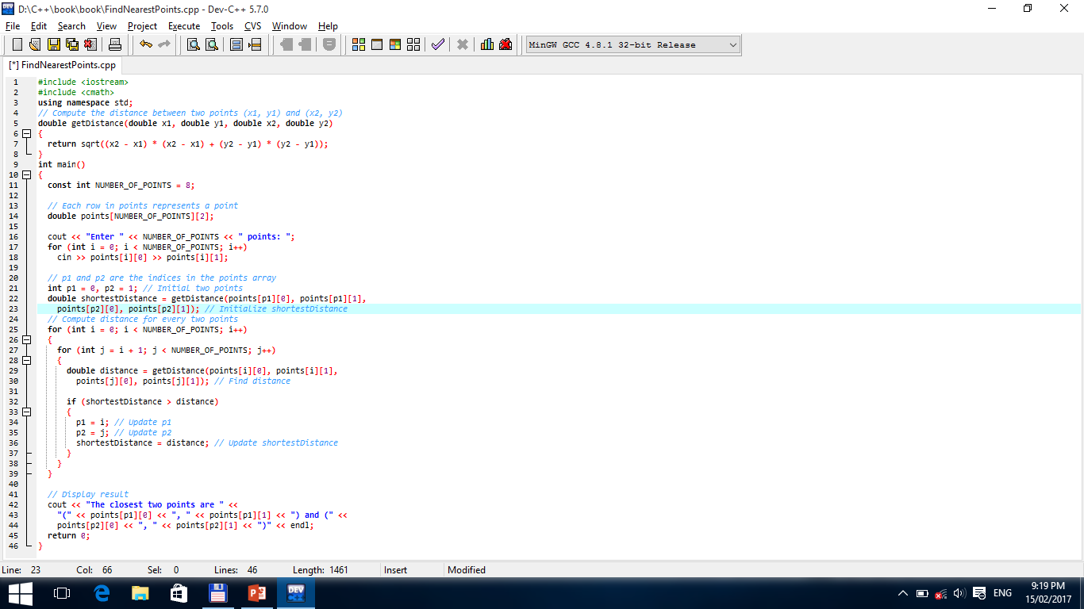
TUIT
Problem: Finding a Closest Pair
This section presents a geometric problem for finding the closest pair of points.
Enter 8 points: -1 3 -1 -1 1 1 2 0.5 2 -1 3 3 4 2 4 -0.5 The closest two points are (1, 1) and (2, 0.5)

Slide 24
TUIT
Problem: Sudoku
The problem is to check whether a given Sudoku solution is correct. Sudoku is a 9 x 9 grid divided into smaller 3 x 3 boxes (also called regions or blocks). Some cells, called fixed cells, are populated with numbers 1 to 9 so that every row, every column, and every 3 x 3 box contains the numbers 1 to 9.
5 | 3 |  |  | 7
6 |  |  | 1 | 9 | 5
 | 9 | 8 |  |  |  |  | 6
8 |  |  |  | 6 |  |  |  | 3
4 |  |  | 8 |  | 3 |  |  | 1
7 |  |  |  | 2 |  |  |  | 6
 | 6
 |  |  | 4 | 1 | 9 |  |  | 5
 |  |  |  | 8 |  |  | 7 | 9
5 | 3 | 4 | 6 | 7 | 8 | 9 | 1 | 2
6 | 7 | 2 | 1 | 9 | 5 | 3 | 4 | 8
1 | 9 | 8 | 3 | 4 | 2 | 5 | 6 | 7
8 | 5 | 9 | 7 | 6 | 1 | 4 | 2 | 3
4 | 2 | 6 | 8 | 5 | 3 | 7 | 9 | 1
7 | 1 | 3 | 9 | 2 | 4 | 8 | 5 | 6
9 | 6 | 1 | 5 | 3 | 7 | 2 | 8 | 4
2 | 8 | 7 | 4 | 1 | 9 | 6 | 3 | 5
3 | 4 | 5 | 2 | 8 | 6 | 1 | 7 | 9
solution

Slide 25
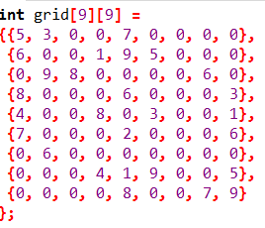
TUIT
Problem: Sudoku
For convenience, we use value 0 to indicate a free cell. The grid can be naturally represented using a two-dimensional array
5 | 3 | 0 | 0 | 7 | 0 | 0 | 0 | 0
6 | 0 | 0 | 1 | 9 | 5 | 0 | 0 | 0
0 | 9 | 8 | 0 | 0 | 0 | 0 | 6 | 0
8 | 0 | 0 | 0 | 6 | 0 | 0 | 0 | 3
4 | 0 | 0 | 8 | 0 | 3 | 0 | 0 | 1
7 | 0 | 0 | 0 | 2 | 0 | 0 | 0 | 6
0 | 6 | 0 | 0 | 0 | 0 | 0 | 0 | 0
0 | 0 | 0 | 4 | 1 | 9 | 0 | 0 | 5
0 | 0 | 0 | 0 | 8 | 0 | 0 | 7 | 9

Slide 26
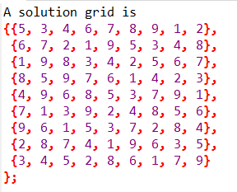
TUIT
Problem: Sudoku
To find a solution for puzzle is to replace 0 in the grid with appropriate numbers between 1 and 9.

Slide 27
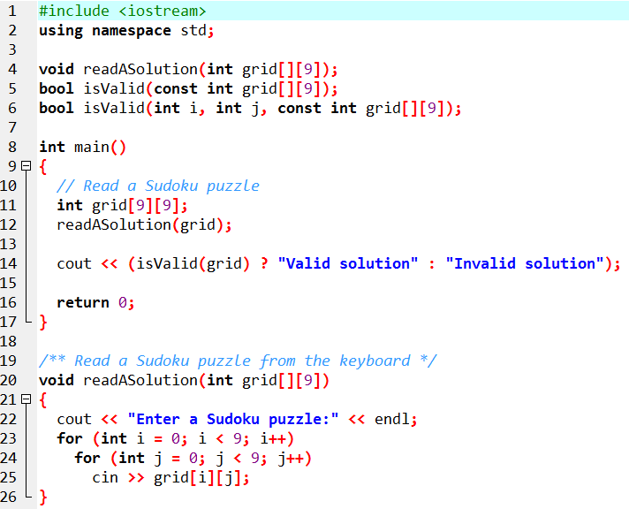
TUIT
Problem: Sudoku

Slide 28
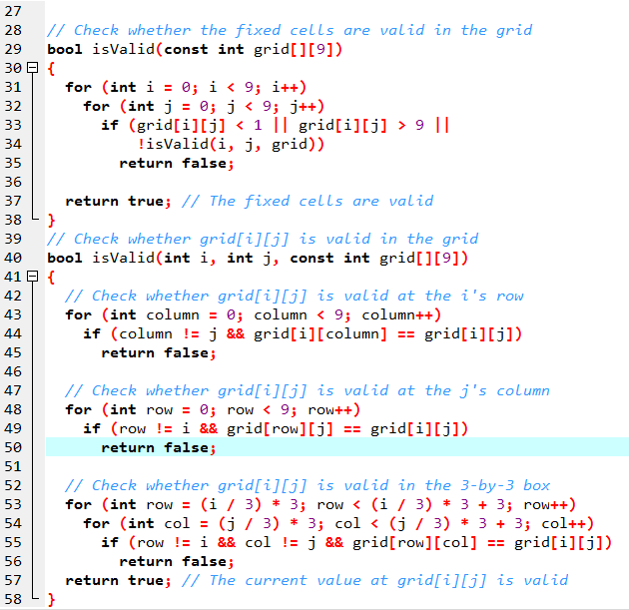
TUIT
Problem: Sudoku
Enter a Sudoku puzzle: 9 6 3 1 7 4 2 5 8 1 7 8 3 2 5 6 4 9 2 5 4 6 8 9 7 3 1 8 2 1 4 3 7 5 9 6 4 9 6 8 5 2 3 1 7 7 3 5 9 6 1 8 2 4 5 8 9 7 1 3 4 6 2 3 1 7 2 4 6 9 8 5 6 4 2 5 9 8 1 7 3 Valid solution

Slide 29
TUIT
Problem: Sudoku
How do you locate all the cells in the same box? For any grid[i][j], the starting cell of the 3 x 3 box that contains it is grid[(i / 3) * 3] [(j / 3) * 3].
grid[0][0]
grid[0][6]
For any grid[i][j] in this 3 x 3 box,
its starting cell is grid[3*(i/3)][3*(j/3)]
(i.e., grid[0][6]). For example, for
grid[2][8], i = 2 and j = 8, 3*(i/3) = 0 and
3*(j/3) = 6.
grid[6][3]
For any grid[i][j] in this 3 x 3 box,
its starting cell is grid[3*(i/3)][3*(j/3)]
(i.e., grid[6][3]). For example, for
grid[8][5], i = 8 and j = 5, 3*(i/3) = 6 and
3*(j/3) = 3.

Slide 30
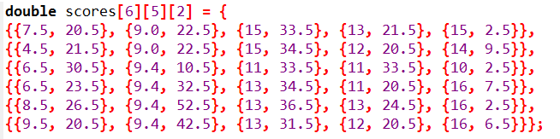
TUIT
Multidimensional Arrays
You can create an array of any dimension in C++. In C++, you can create n – dimensional arrays for any integer n. For example, you may use a three – dimensional array to store exam scores for a class of six students with five exams and each exam has two parts.

Slide 31
TUIT
Multidimensional Arrays
scores[0][1][0] refers to the multiple-choice score for the first student’s second exam, which is 9.0. scores[0][1][1] refers to the essay score for the first student’s second exam, which is 22.5. This is depicted in the following figure:
Which student
Which exam
Multiple-choice or essay
scores [i] [j] [k]

Slide 32
TUIT
Problem: Daily Temperature and Humidity
Suppose a meteorology station records the temperature and humidity at each hour of every day and stores the data for the past 10 days in a text file named weather.txt. Each line of the file consists of four numbers that indicate the day, hour, temperature, and humidity. Your task is to write a program that calculates the average daily temperature and humidity for the 10 days.

Slide 33
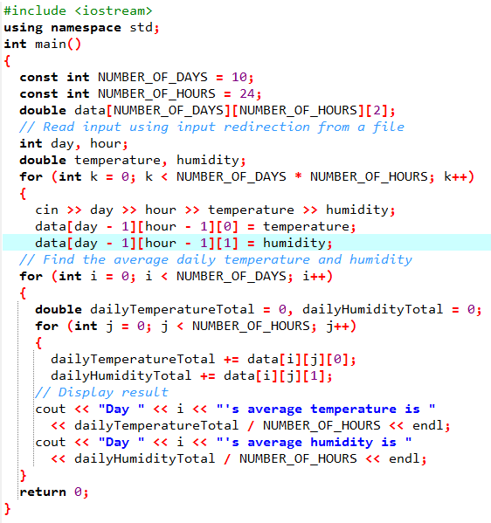
TUIT
Problem: Daily Temperature and Humidity
Day 0’s average temperature is 77.7708 Day 0’s average humidity is 0.929583 Day 1’s average temperature is 77.3125 Day 1’s average humidity is 0.929583 … Day 9’s average temperature is 79.3542 Day 9’s average humidity is 0.9125

Slide 34
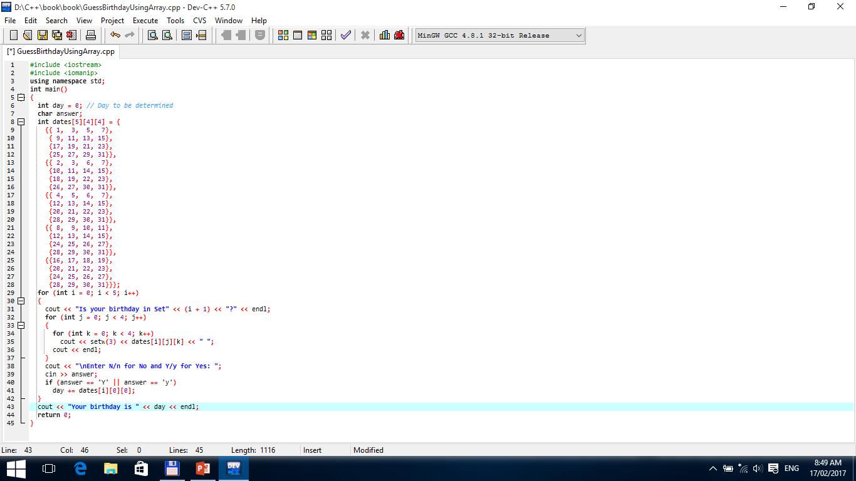
TUIT
Problem: Guessing Birthdays
Is your birthday in Set1? 1 3 5 7 9 11 13 15 17 19 21 23 25 27 29 31 Enter N/n for No and Y/y for Yes: Y Is your birthday in Set2? 2 3 6 7 10 11 14 15 18 19 22 23 26 27 30 31 … Enter N/n for No and Y/y for Yes: N Is your birthday in Set5? 16 17 18 19 20 21 22 23 24 25 26 27 28 29 30 31 Enter N/n for No and Y/y for Yes: Y Your birthday is 19

Slide 35
TUIT
Summary
A two-dimensional array can be used to store a table.
A two-dimensional array can be created using syntax: elementType arrayName[ROW_SIZE][COLUMN_SIZE].
Each element in two-dimensional array is represented using the syntax: arrayName[rowIndex][columnIndex].
You can create initialize a two – dimensional array using an array initializer with the syntax: elementType arrayName[][COLUMN_SIZE] = {{row values}, … , {row values}}.
You can pass a two-dimensional array to a function; however, C++ requires that the column size be specified in the function declaration.
You can use array of arrays to from multidimensional arrays. For example, a three-dimensional array is declared as an array of arrays using the syntax elementType arrayName[size1][size2][size3].

